Slide 1








Hospital
Information System
Presented By :
Pratibha JD

Slide 2




Project Overview
Objective:
Manage hospital and doctor records using SQL
Tools Used:
SQL Server Management Studio (SSMS)
Tables:
Hospital (Hospital_Id [PK] , Name, Bed_Count)
Doctor (Doctor_Id [PK], Doctor_Name,
Hospital_Id [FK], Joining_Date, Specialty,
Salary, Experience)

Slide 3




Tasks Performed in Microsoft SQL Sever
Tasks:
1. Connect to your database server and print its version .
2. Add 50 sample records.
3. Fetch Hospital and Doctor Information using hospital Id and
doctor Id.
4. Get the list of the doctors as per given specialty and salary
5. Get the list of the doctors from a given hospital.
6. Update doctor experience in years .

Slide 4


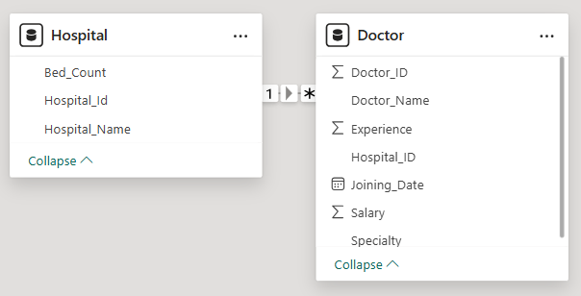


Database Design
[PK]
[PK]
[FK]
[PK] – Primary Key
[FK] – Foreign Key
- - One-to-Many relationship
(One hospital can have many doctors, but each doctor belongs to one hospital)

Slide 5
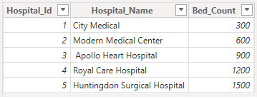

Table Structure
Table Structure for Hospital :

Slide 6
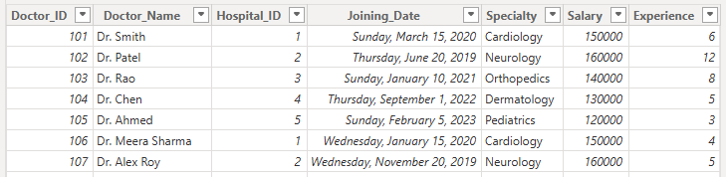
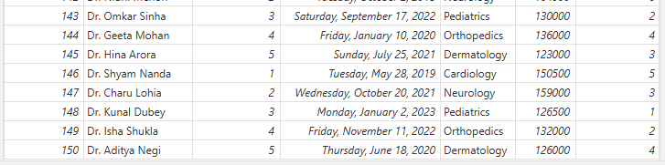
Table Structure
Table Structure for Doctor

Slide 7



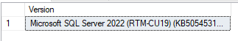

1. Connect to your database server and print its version
SQL Query :
Output :

Slide 8


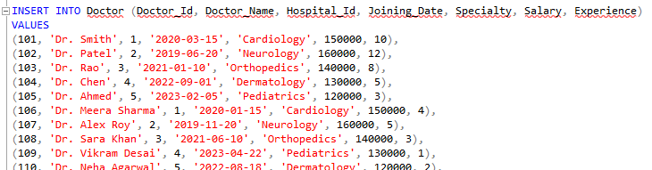

`
2. Add 50 Sample Records
SQL Query :

Slide 9
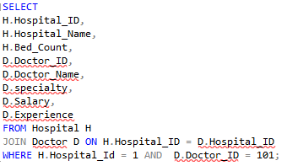
3. Fetch Hospital and Doctor Information using hospital Id and doctor Id
SQL Query :
Output :

Slide 10

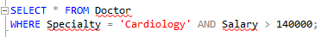

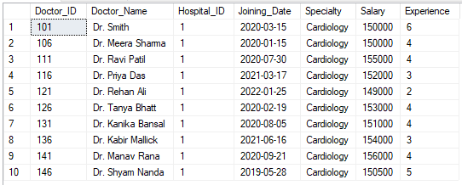
4.Get the list of the doctors as per given specialty and salary
SQL Query:
Output :

Slide 11



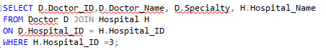
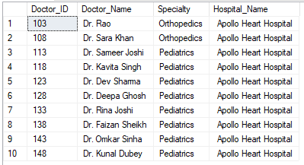
5.Get the list of the doctors from a given hospital
SQL Query :
Output :

Slide 12
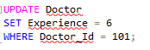
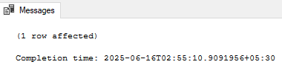
6. Update doctor experience in years
SQL Query:
Output :

Slide 13
Thank You

